Slide 1
Sleep Health and Lifestyle Analysis
Data Analytics - IBM Internship

Slide 2

INTRODUCTION
Sleep is essential for physical and mental health, impacting everything from immune function to cognitive performance. Chronic sleep deprivation can lead to serious health issues like obesity, diabetes, and mental disorders, while adequate sleep enhances mood, concentration, and overall well-being.
Poor sleep can negatively impact decision-making, relationships, and long-term health, leading to reduced quality of life. Prioritizing sleep and making positive lifestyle changes are vital for overall health and well-being
approximately 2.4 to 3.6 billion people may be affected by sleep disorders to some extent.

Slide 3
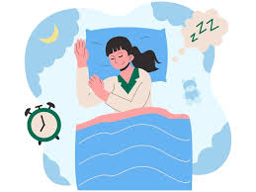

PURPOSE OF THE PROJECT
The objective of this data analysis project is to explore the correlation between sleep health and lifestyle factors, including diet, exercise, and screen time. By analyzing patterns and trends within these variables, the project aims to identify significant contributors to sleep quality.
This analysis will provide actionable insights to inform interventions and recommendations for improving sleep health. Ultimately, the findings will contribute to a better understanding of how daily habits influence sleep, supporting healthier lifestyle choices and overall well-being.

Slide 4
SOURCE OF DATA USED
Data Source - Data is taken from Kaggle. There are several attributes in the data set on the basis of which we are analyzing and visualizing the Sleep disorder.

Slide 5
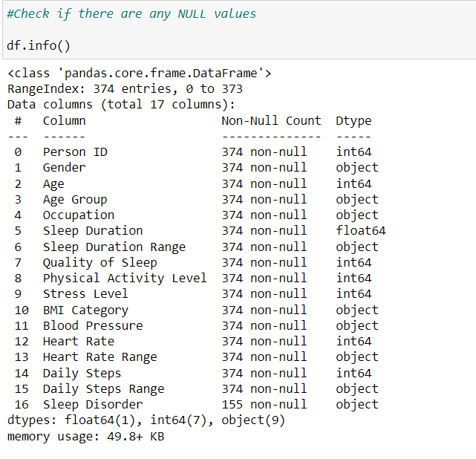
DATA BEFORE CLEANING

Slide 6
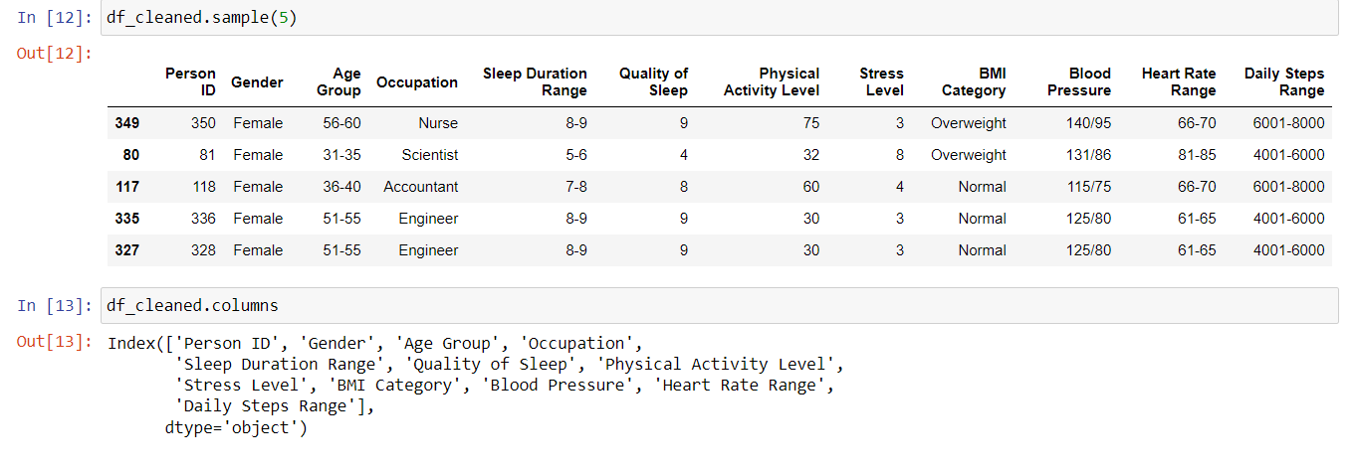
DATA AFTER CLEANING

Slide 7
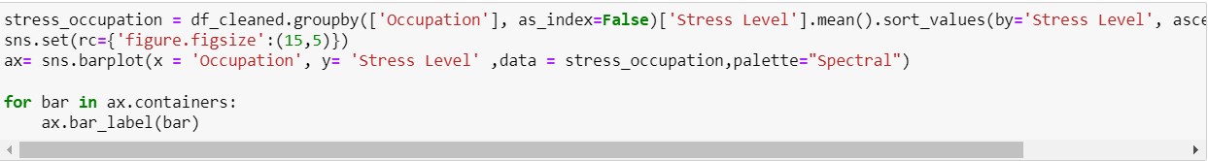
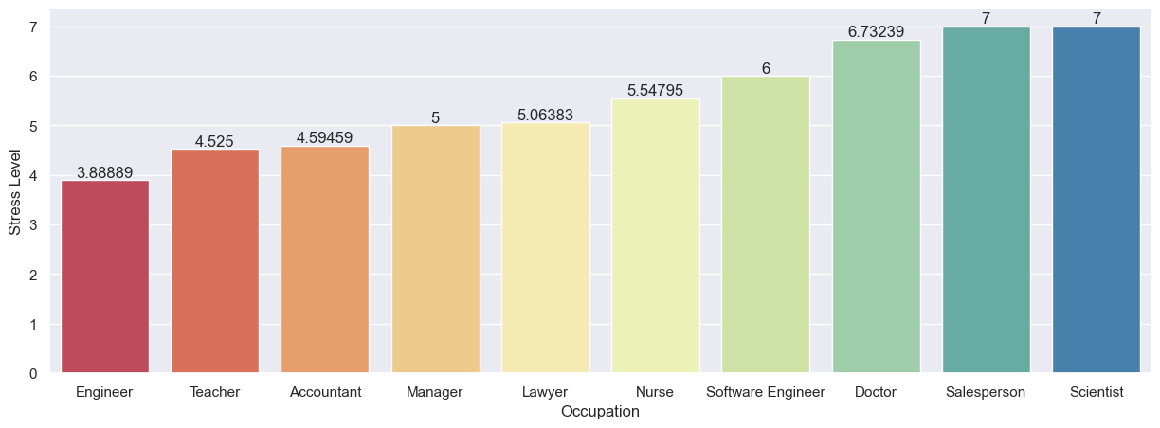
DATA VISUALIZATION

Slide 8
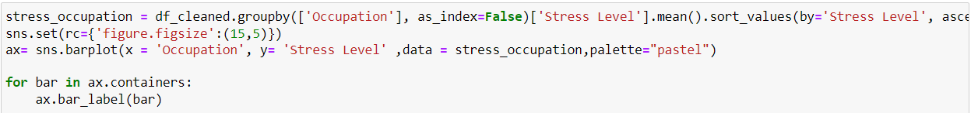
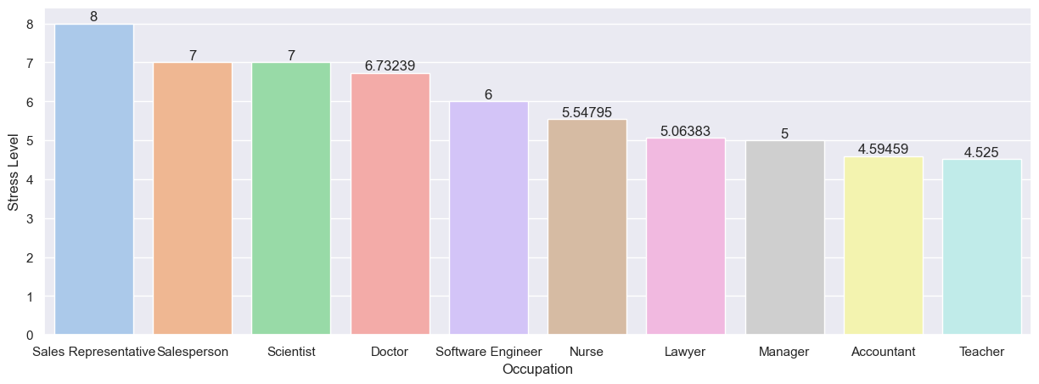
Stress level by Occupation

Slide 9
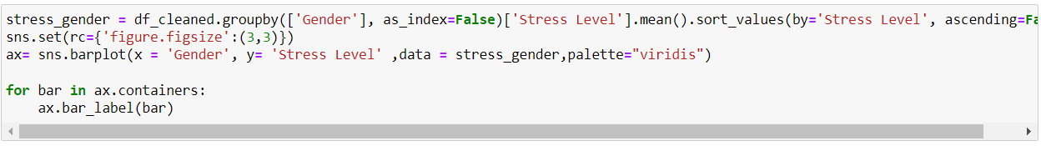
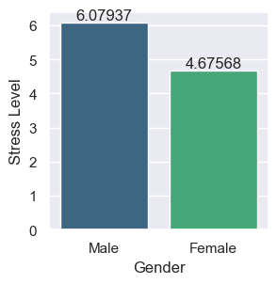
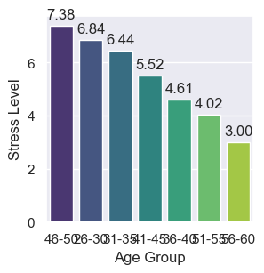
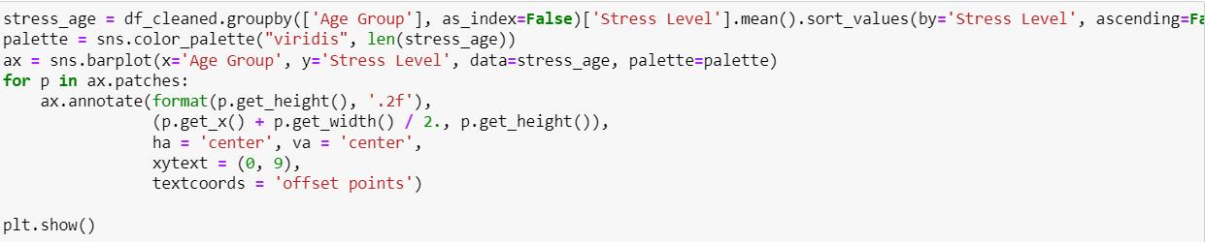
Stress level by Age Group
Stress level by Gender

Slide 10
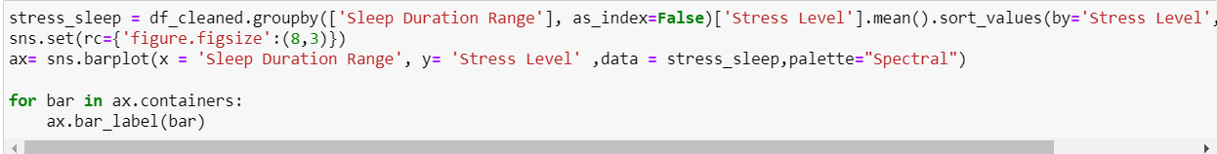
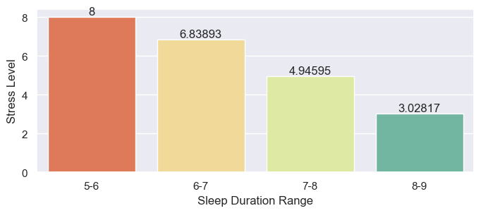
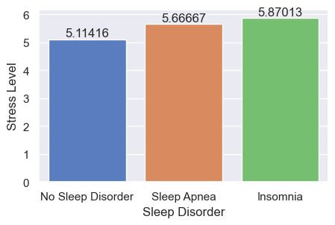
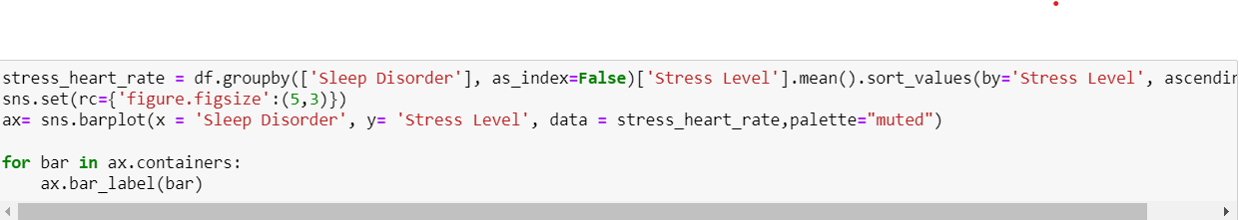
Stress level by Sleep Disorder
Stress level by Sleep Duration

Slide 11
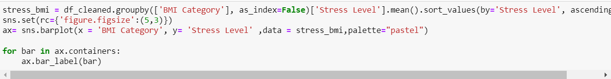
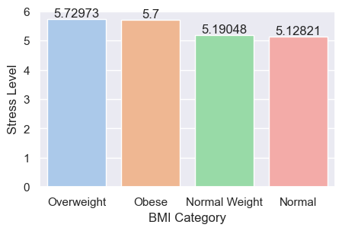
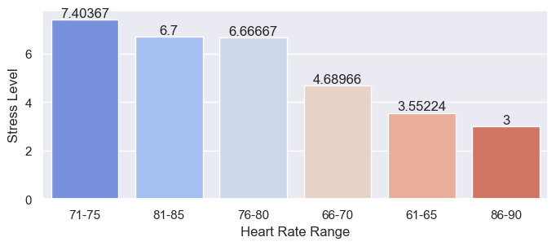
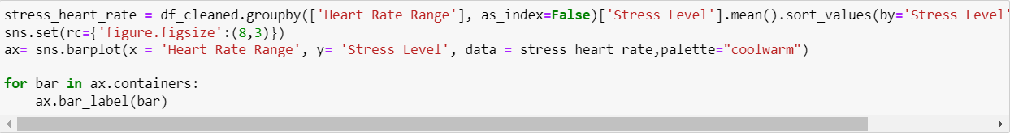
Stress level by Heart Rate
Stress level by BMI

Slide 12
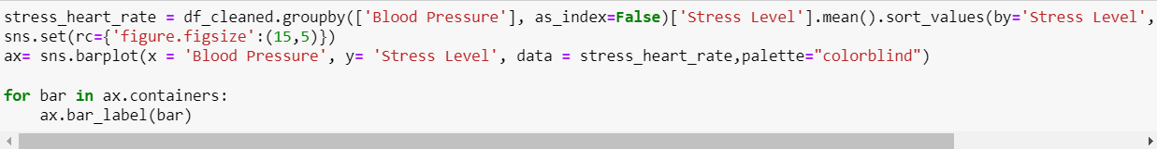
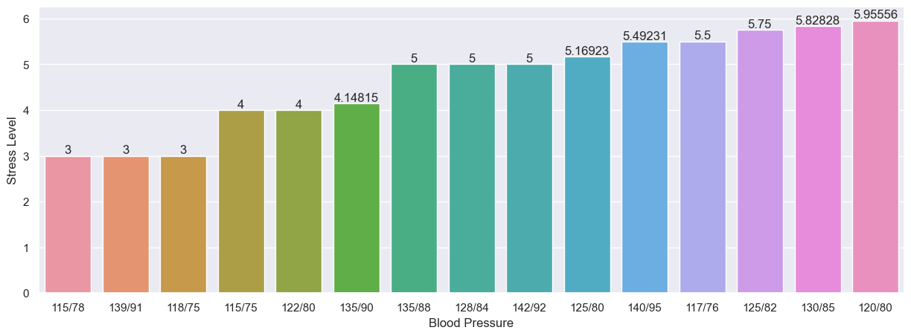
Stress level by Blood Pressure

Slide 13
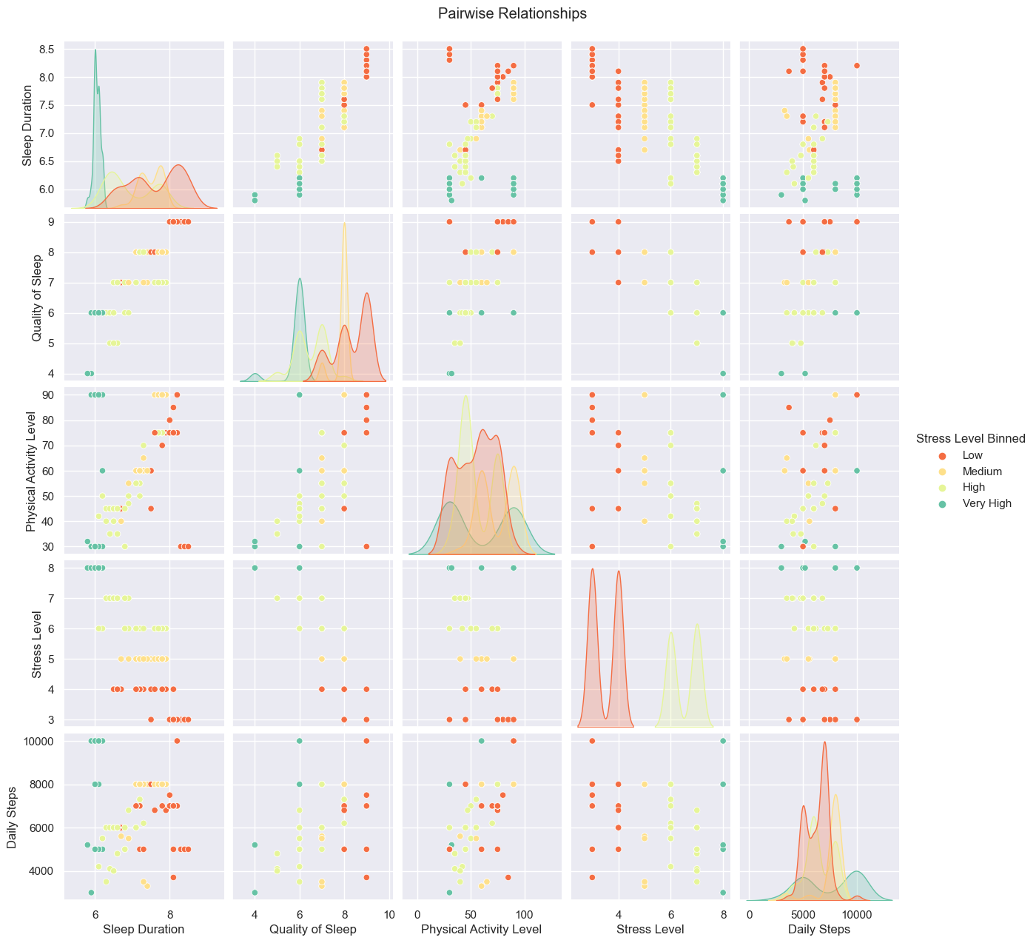

Slide 14
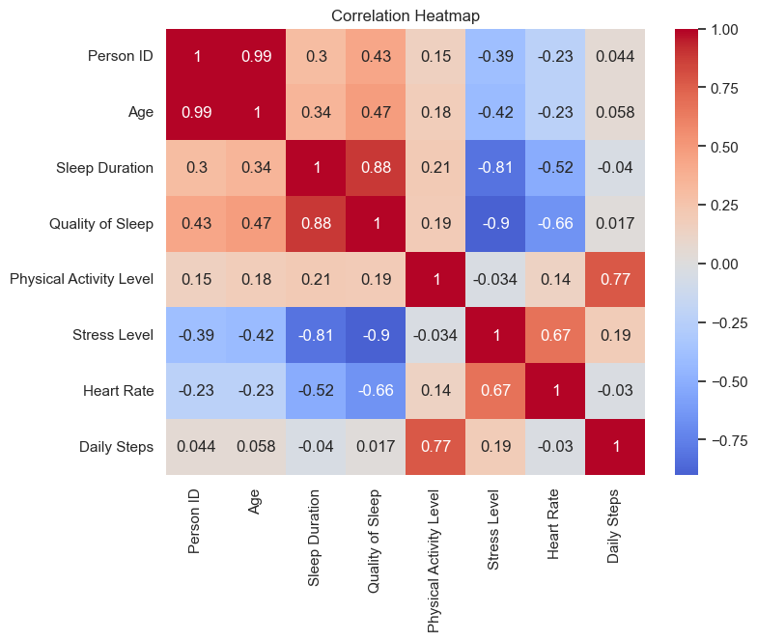

Slide 15
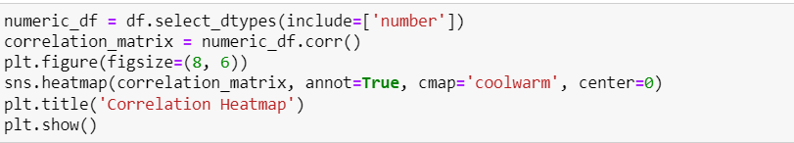
Pair Plot
Correlation Matrix

Slide 16
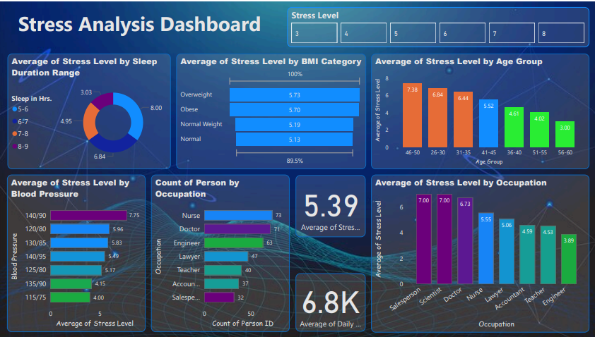
DATA VISUALIZATION USING POWER BI

Slide 17
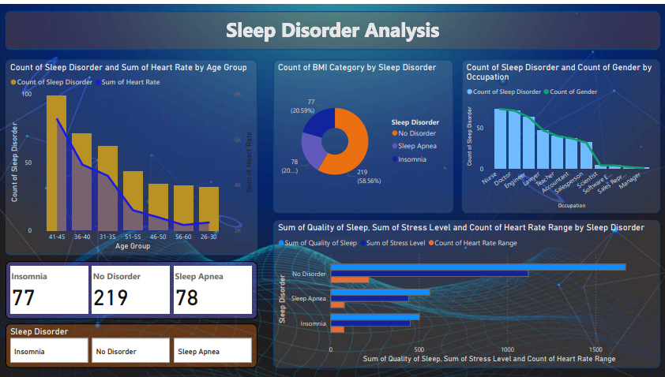

Slide 18

CONCLUSION
Men aged 46-50 years who:
Occupation: Work as Sales Representatives
Sleep Duration: Sleep for 5-6 hours
BMI Category: Have an Overweight BMI
Heart Rate: Have a heart rate between 71-75
Blood Pressure: Have blood pressure between 131/86
Exhibit the highest stress levels

